Slide 1
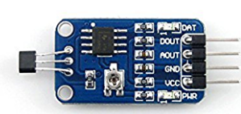
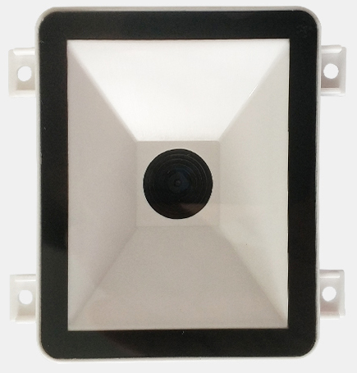
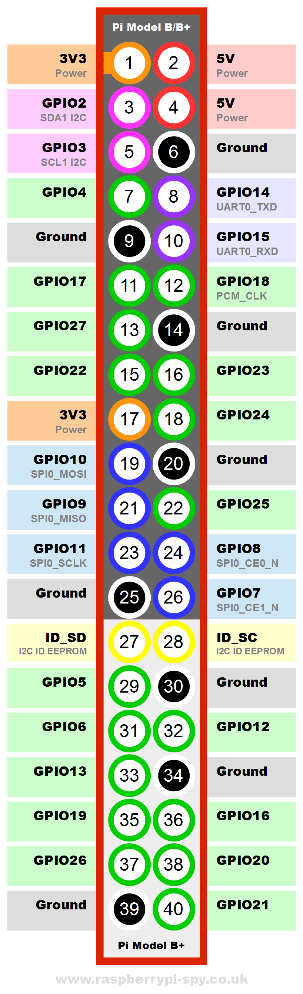
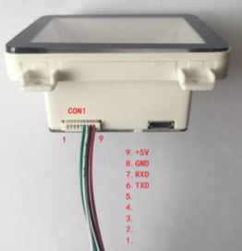
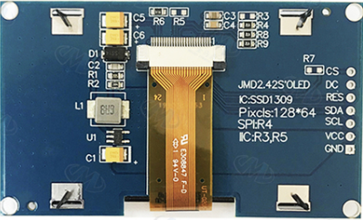
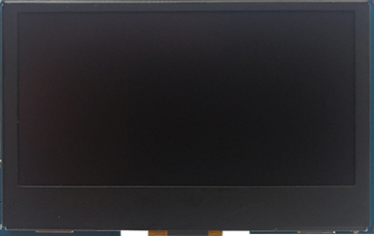
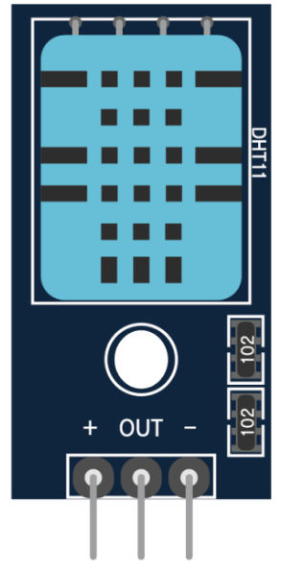
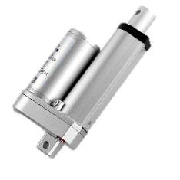
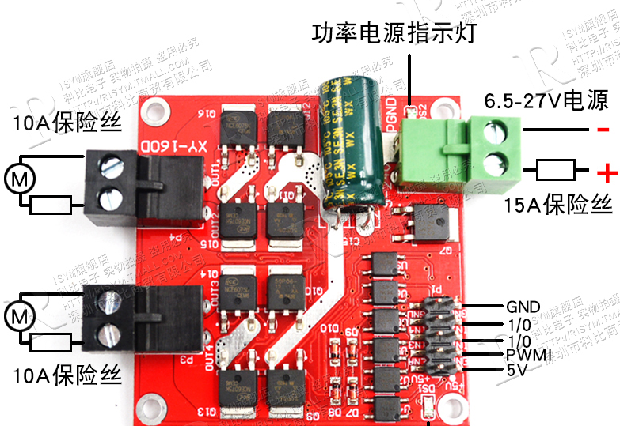
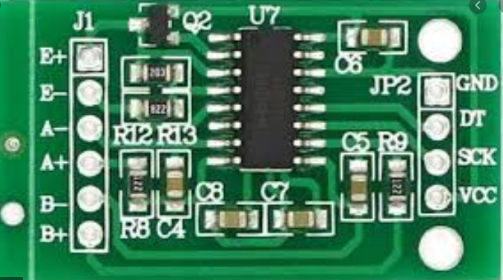
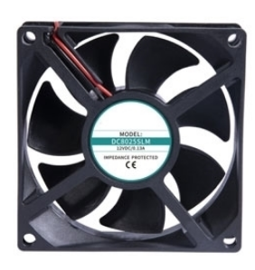
VCC(24V)
Switch Power supply
(24v, 14A)
VCC(5V)
GND
RX(pin7)
Transformer
(24V-5v)
TX(pin6)
EN(rood rot)-GPIO22
Door Up&Down actuator
IN2(doorup)
EN(door up)-GPIO5
E+
IN1(doorup)
E-
Load cell #2
SCK
A-
IN3(door_rotation)
A+
Door Rotation actuator
IN4(door_rotation)
GND
DT
E+
Load cell #1
SCK
E-
VCC(24V)
EN
A-
Hopper Actuator
IN1
DT
A+
IN2
GPIO9 - IN1, EN

Slide 2
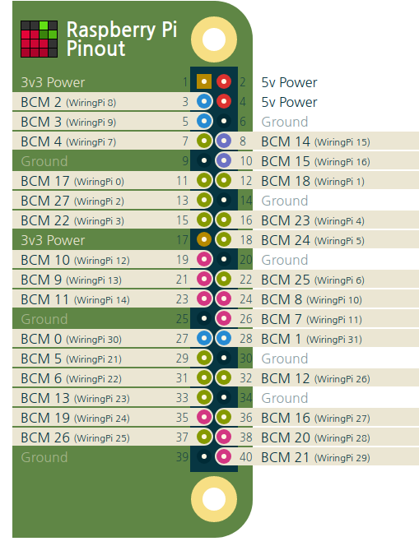
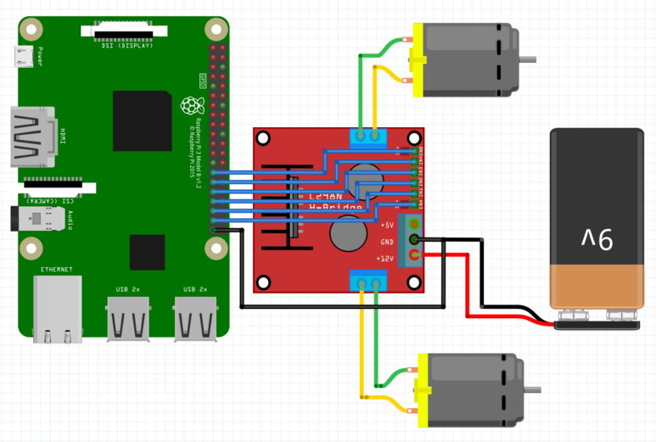

Slide 3
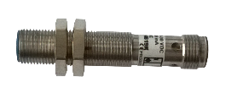
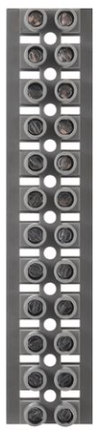
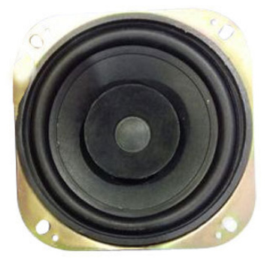

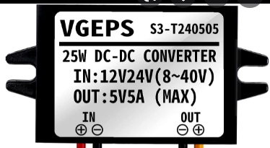
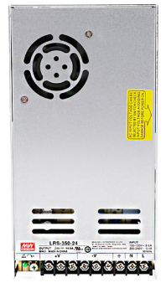
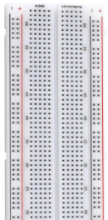
Hopper
Door Rotation
Door Up&down

Slide 4
Door open test
0. Start
1. Door is at home position
2. Door is going up
3. Door is at the rotatable position
4. Door is rotating
5. Door is at opened position
6. Door is rotating reverse
7. Door is at the rotatable position
8. Door is going down
9. Door is at home position
10. Completed
O.K / N.O
O.K / N.O
O.K / N.O
O.K / N.O
O.K / N.O
O.K / N.O
O.K / N.O
O.K / N.O
O.K / N.O
O.K / N.O
O.K / N.O
Hall effect sensor #1
Hall effect sensor #2
Hall effect sensor #3
Hall effect sensor #4
Hopper test
0. Start
1. Hopper is opening
2. Hopper is closing
3. Completed
O.K / N.O
O.K / N.O
O.K / N.O
O.K / N.O
Temp
##
Humi
##
OLED test
0. Start
1. Display #1
2. Display #2
3. Completed
O.K / N.O
O.K / N.O
O.K / N.O
O.K / N.O
Speaker test
0. Start
1. test #1
2. test #2
3. Completed
O.K / N.O
O.K / N.O
O.K / N.O
O.K / N.O
QR scanner test
0. Start
1. Scan QR code
2. Scanned and your QR is :
3. Completed
O.K / N.O
O.K / N.O
O.K / N.O
O.K / N.O
Cooling fan
0. Start
1. Fan #1 operation
2. Fan #2 operation
3. Completed
O.K / N.O
O.K / N.O
O.K / N.O
O.K / N.O
Load cell test
0. Start
1. Your weight is :
2. Completed
O.K / N.O
O.K / N.O
O.K / N.O
Tare
Calibration

Slide 5
Main page
Door open test
Hopper test
OLED test
Speaker test
QR scanner test
Cooling fan
Load cell test

Slide 6

Door open test
Start
1. Door is at home position
(1. Please check hall effect sensor)
If fail
2. Door is going up – Please check actual operation
3. Door is at rotatable position
(3. Please check hall effect sensor)
4. Door is rotating – Please check actual operation
5. Door is at opened position
(5. Please check hall effect sensor)
6. Door is rotating reverse– Please check actual operation
7. Door is at rotatable position
(7. Please check hall effect sensor)
8. Door is going down – Please check actual operation
9. Door is at home position
(9. Please check hall effect sensor)
End
Home

Slide 7
Hopper test
Start
1. Hopper door opening – Please check actual operation
2. Hopper door closing– Please check actual operation
End
Home

Slide 8
OLED test
Start
1. Display #1 : AEL
2. Display #2 : ARCS inlet system
End
Home

Slide 9
Speaker test
Start
1. sound #1
2. sound #2
End
Home

Slide 10
QR code scanner
test
Start
1. Please scan your QR code
2. Scanned and your QR is
XXX
End
Home

Slide 11
Temp, humi
and cooling
fan test
Temp
##
Humi
##
Cooling fan #1 test
Cooling fan #2 test
Home

Slide 12
Load cell
test
Current weight output :
A/D value : 2031
Weight result : XXX kg
Next
Home

Slide 13
Load cell
zero setting
Adjustment of zero point:
A/D value of left L/C : 2031
A/D value of right L/C : 3162
Avg of value : 2523
Current weight : xx kg
Click to zero setting
Adjustment of zero point:
A/D value of left L/C : 2031
A/D value of right L/C : 3162
Avg of value : 2523
Current weight : 0 kg
Home

Slide 14
Load cell
Calibration 1
Put your standard weight
20kg
Next
Home

Slide 15
Load cell
Calibration 2
Span adjust
20kg
L : 8504 R : 9684
Press ‘Next’ when both value get stable
Next
Home

Slide 16
Load cell
Calibration 3
Weight display
20.00kg
Finish
Home

